Slide 1
Basics to R Correlation, Linear Regression, and ANOVA

Slide 2
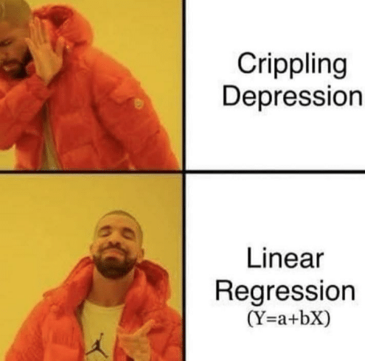
Outline for Today
What are inferential statistics?
The General Linear Model
Correlation, Linear Regression, and ANOVA
What do I need to look at?
Basic data visualization of inferential statistics in ggplot2

Slide 3
What are inferential statistics?
Statistics
Descriptive Statistics
Inferential Statistics

Slide 4
What are inferential statistics? A very brief introduction to the General Linear Model
Structural Equation Modeling
Regression Analyses
Canonical Correlation
General Linear Model

Slide 5
What are regression analyses?
Regression Analyses
Chi Square
Linear Regression
Correlation
(i.e., Pearson’s r, etc.)
ANOVA and
ANCOVA

Slide 6
What are the assumptions of regression analyses?
Linearity
Independence
Normality
Equivariance (i.e., Homoscedasticity)

Slide 7
Assumption #1: Linearity
The regression model is linear in parameters
Y = a + (β1*X1) + (β2*X2)
Y = a + (β1*X1) + (β2*X2²) Y = a + (β1*X1) + (β2*X2²) + (β2*ln(X2))
Y ≠ a + (β1*X1) + (β2*X2)²

Slide 8
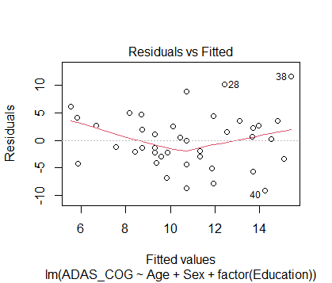
Assumption #2: Independence
Observations are independent of each other

Slide 9
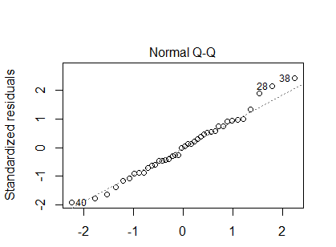
Assumption #3: Normality
Residual errors are normally distributed

Slide 10
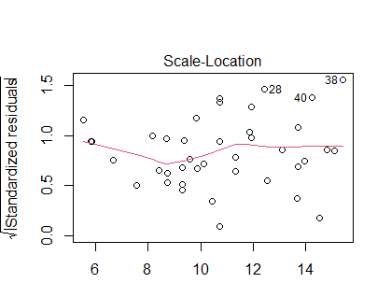
Assumption #4: Equivariance or Homoscedasticity
The variance of residuals should not increase with fitted values of the response variable.

Slide 11

Summary
The fundamental basis of most statistics is rooted in the same mathematics
This means that how you write your R code is pretty much the same for many common analyses
Most inferential statistics are based on assumptions about the data which need to be checked

